Slide 1
Project name :
Data Literacy With Tableau
Team id:
NM2023TMID07827
Team lead name:
BE17E7B3F115C94B7FA474EBCCA688B8
Project Title:
Unveiling Market Insights: Analysing Spending Behaviour And Identifying Opportunities For Growth.

Slide 2
Team members ID :
1ED631D9785E3B987374054E16F11047
1BA8E8A91E5B9E4AFFE4F2D980ED5C24
365199A10E54D6FA34D4C3E8596C06B2
3611490588D9A6A9AE14CEDDA9FF79A4

Slide 3
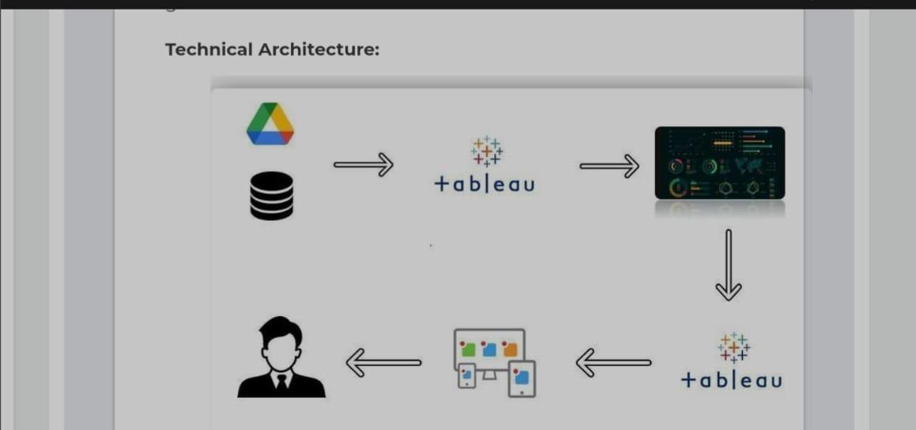

Slide 4
Introduction :
Unveiling Market Insights: Analysing Spending Behaviour And Identifying Opportunities For Growth Wholesaling or distributing is the sale of goods to retailer to industrial, commercial, institutional or other professional businessman to other wholesalers (wholesale businesses) and related subordinated services. Wholesaling is buying goods in bulk quantity, usually directly from the manufacturer or source, at a discounted rate. The retailer then sells the goods to the end consumer at a higher price making a profit The consumption and production of marketed food are spatially separated. Production is primarily in rural areas while consumption is mainly in urban areas. IN today’s highly competitive business landscape, gaining deep market insights is essential for businesses to thrive and grow. This project aims to analyse customer spending behavior and identify opportunities for growth by leveraging data analytics and data-driven decision-making The primary objective of this project is to understand customer spending patterns, preferences, and trends across various dimensions.. By conducting a comprehensive analysis, businesses can optimize their marketing strategies, improve product offerings, and enhance customer engagement to drive revenue growth

Slide 5
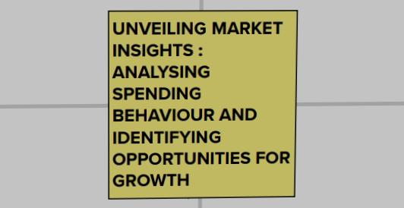
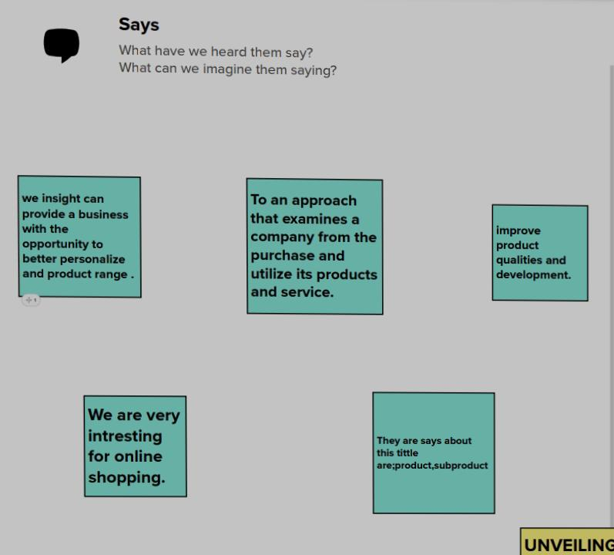
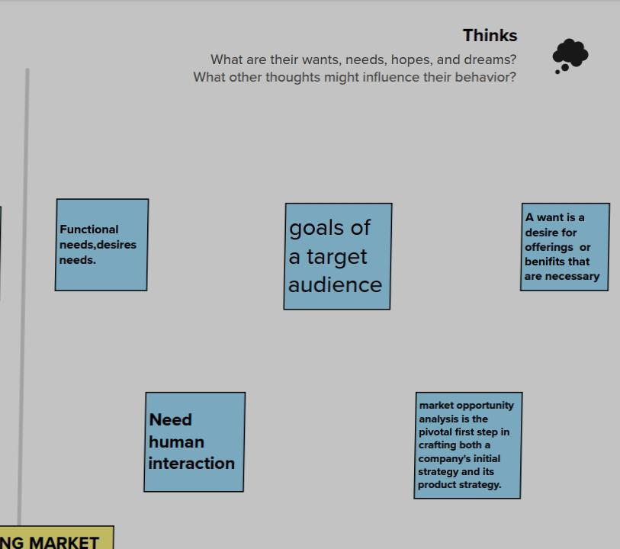
Empathy map

Slide 6
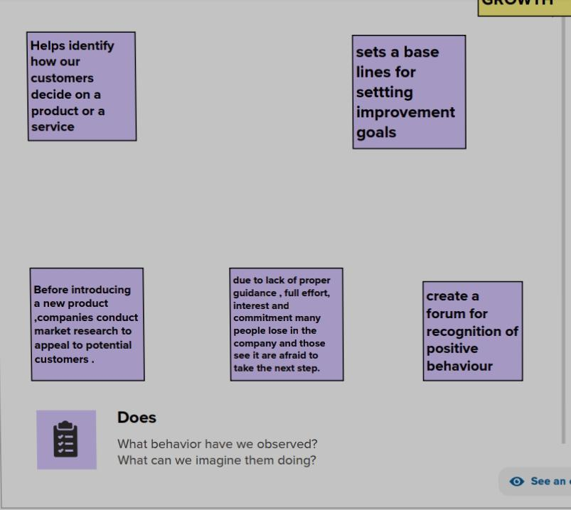
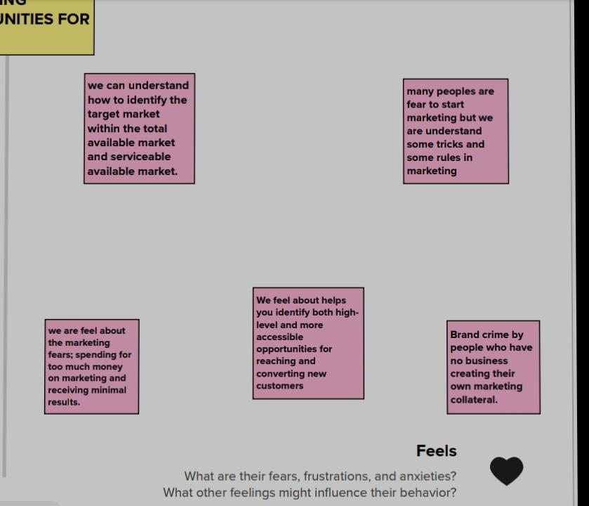

Slide 7
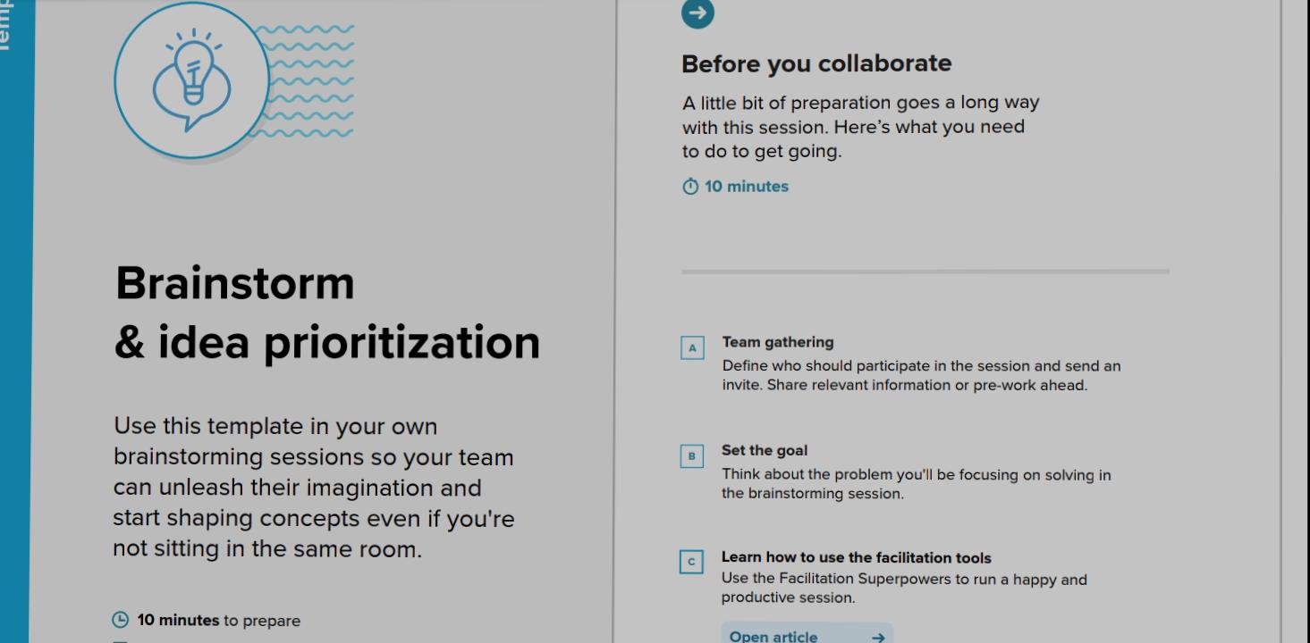
Brainstorming

Slide 8
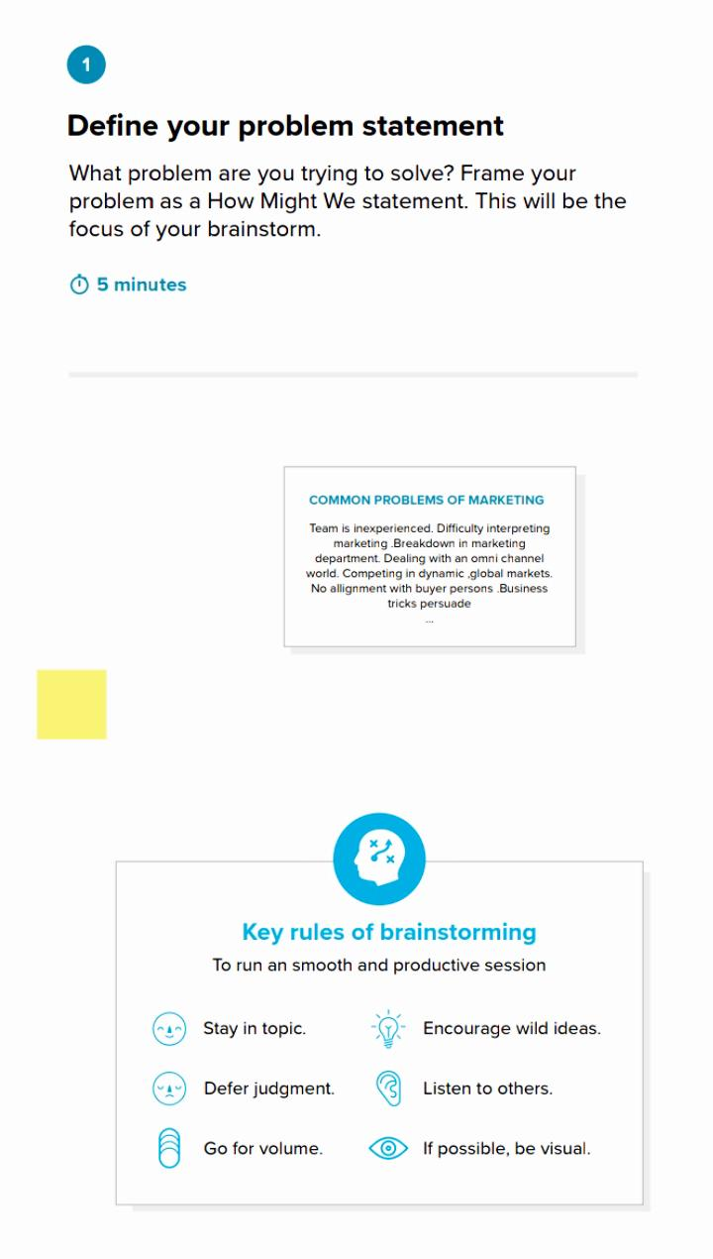
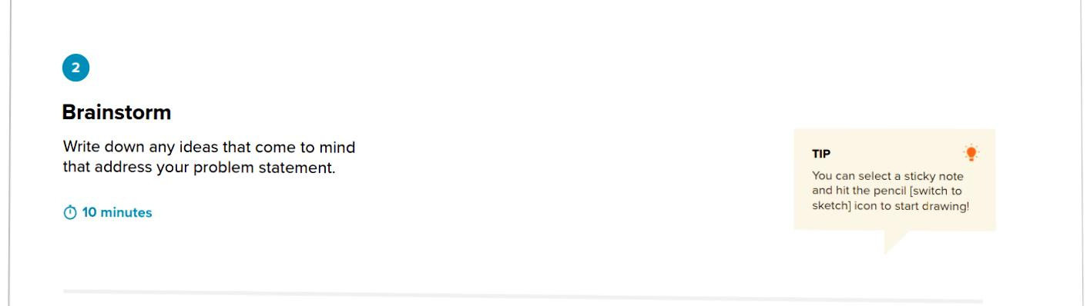
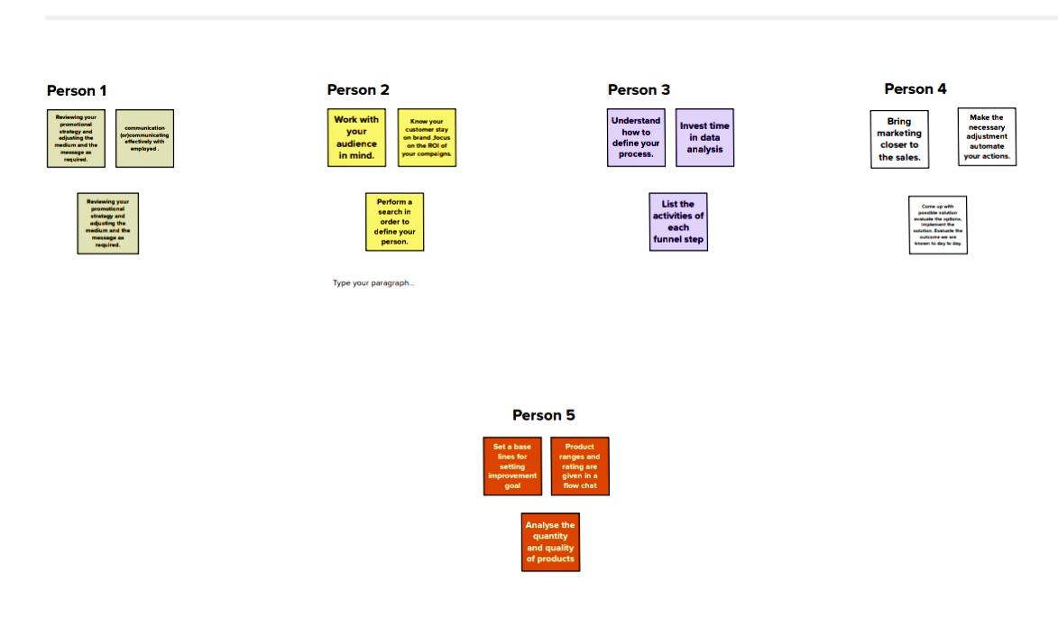

Slide 9
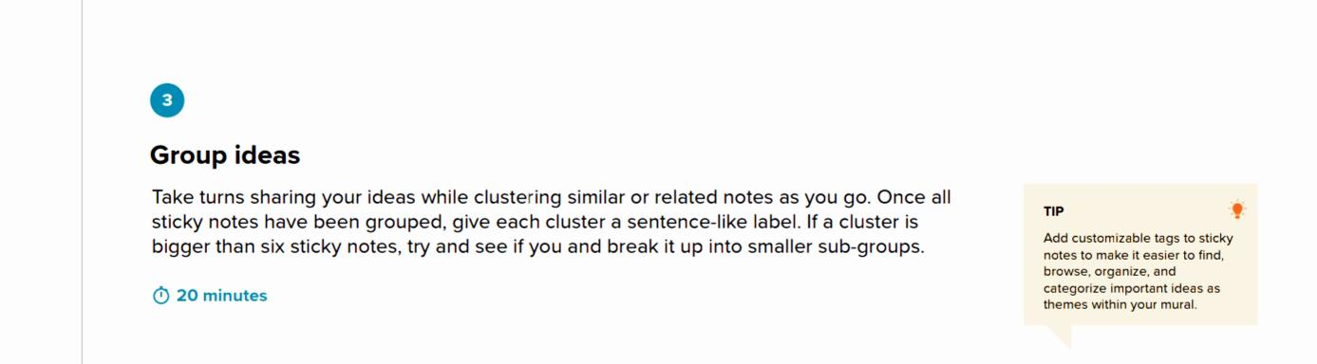
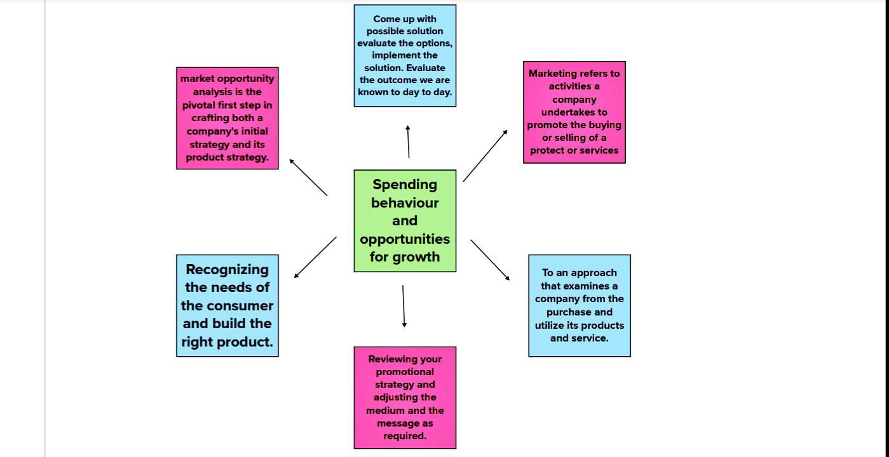

Slide 10
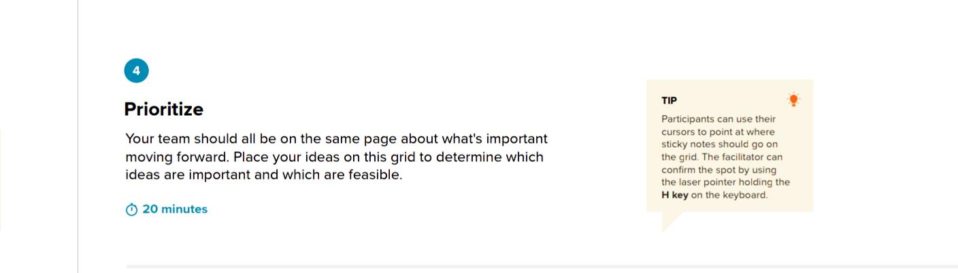
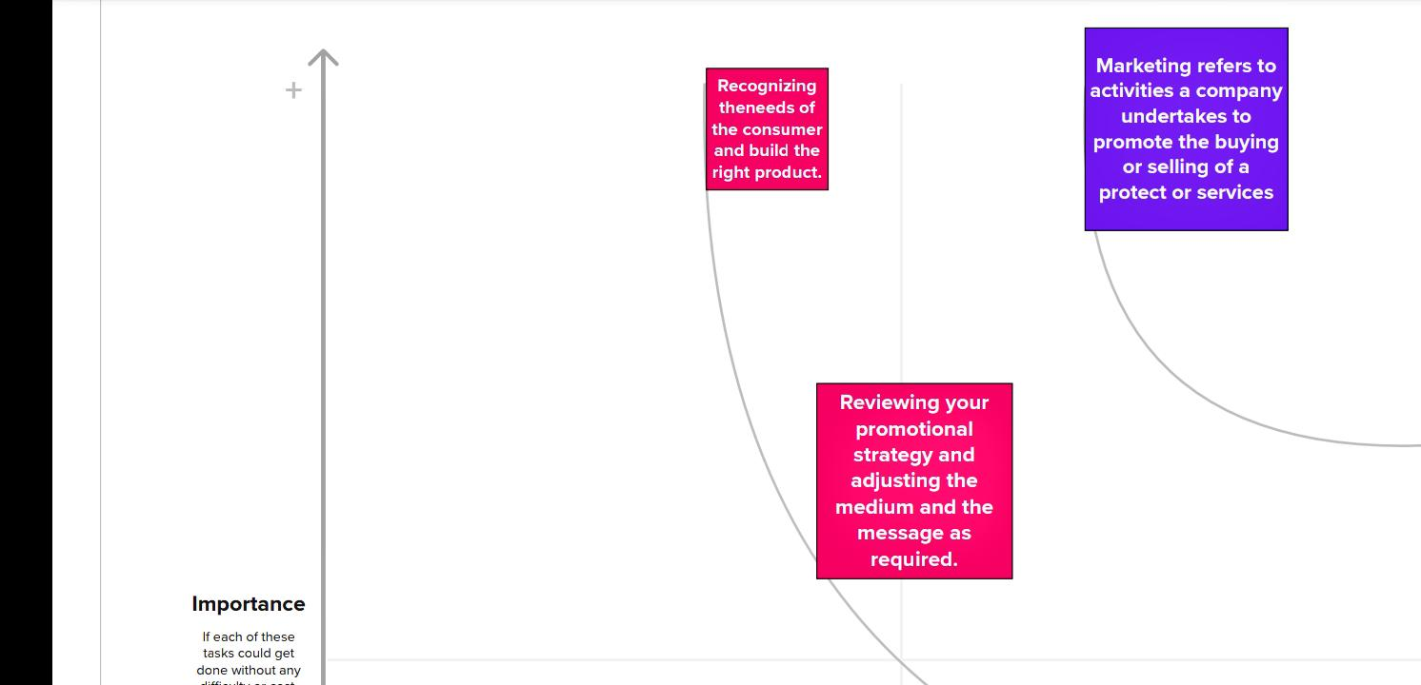

Slide 11
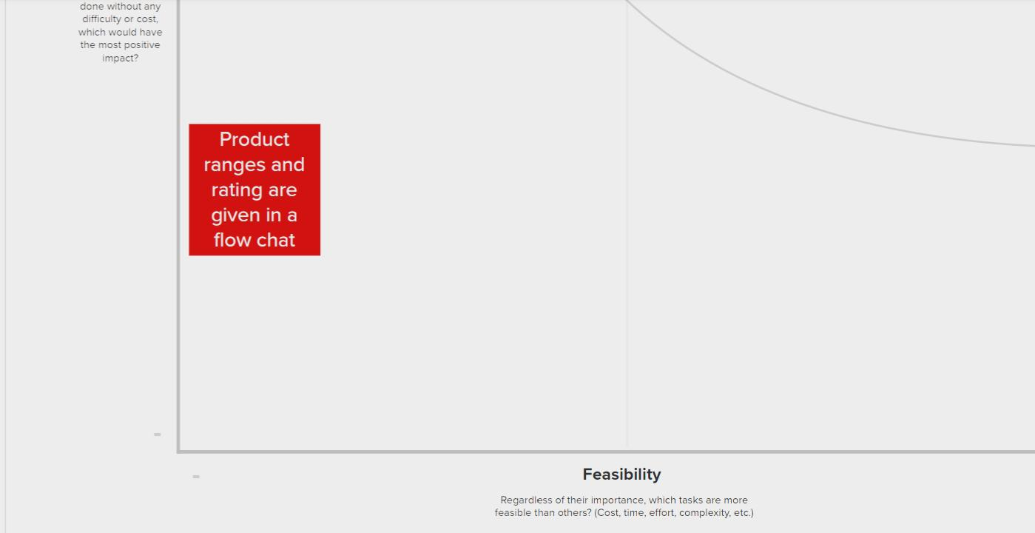

Slide 12
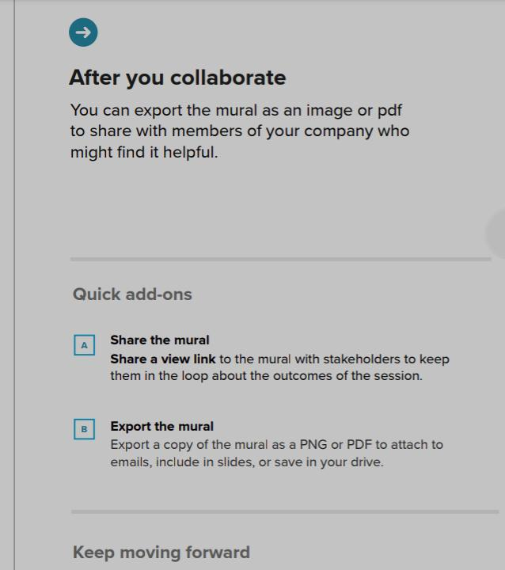
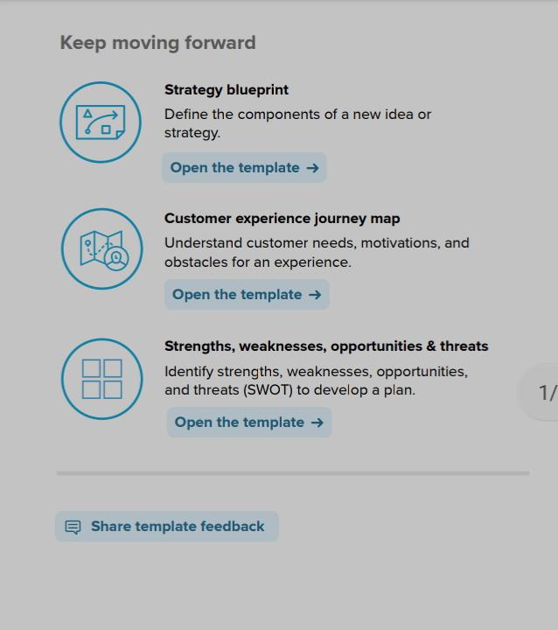

Slide 13
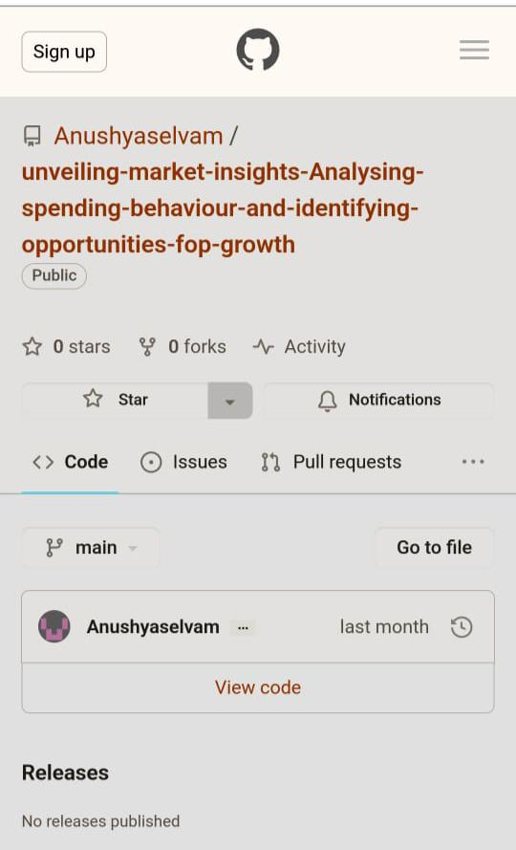
Upload on GitHub With link
https://github.com/Anushyaselvam/unveiling-market-insights-Analysing-spending-behaviour-and-identifying-opportunities-fop-growth.git

Slide 14
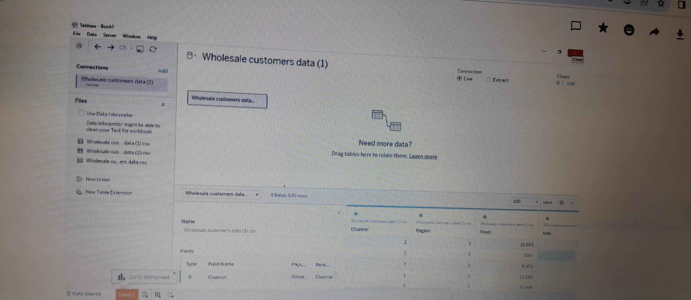
Dataset

Slide 15
Data visualization

Slide 16
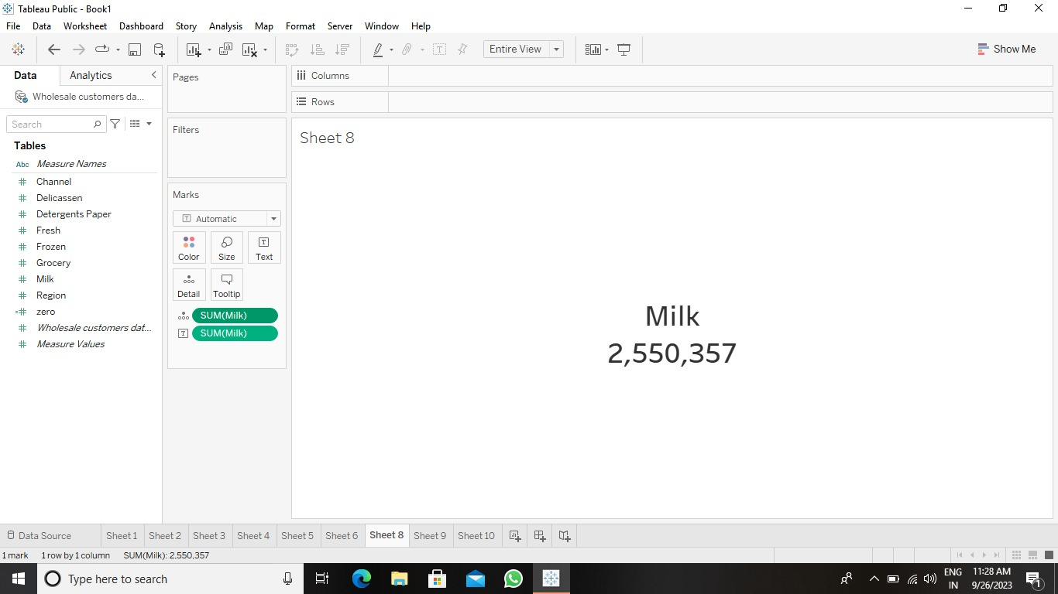
KPI’s

Slide 17
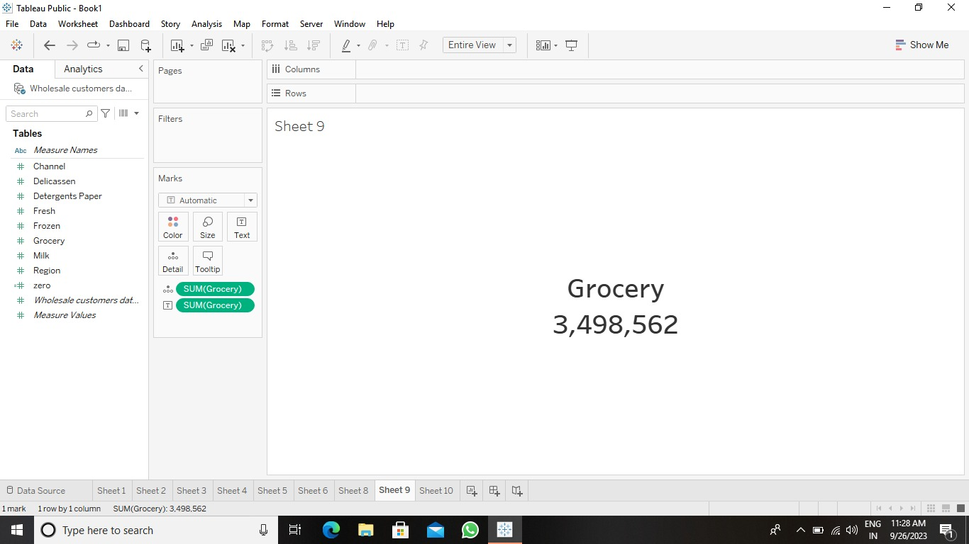

Slide 18


Slide 19
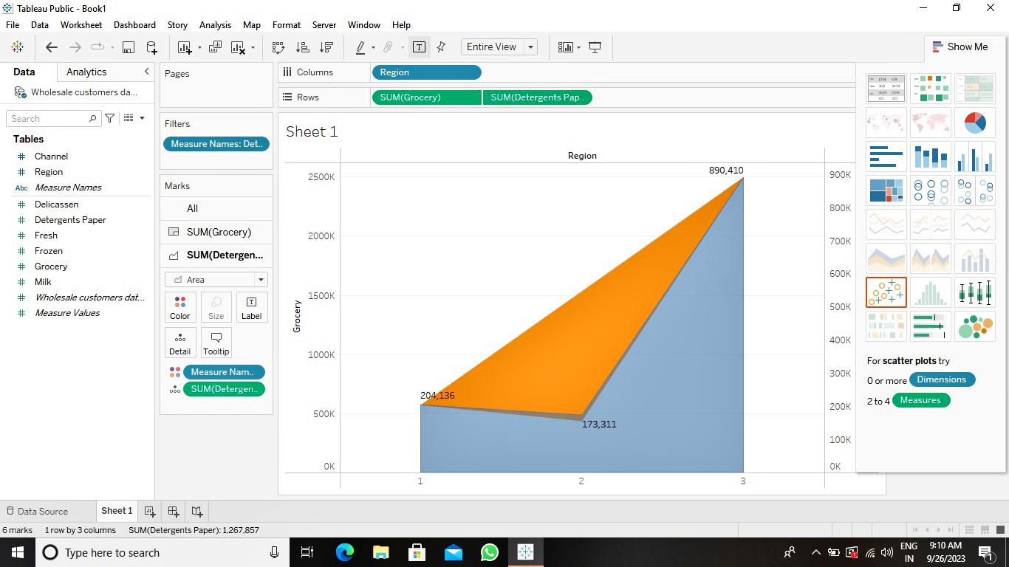
Region wise Grocery and Detergent paper

Slide 20
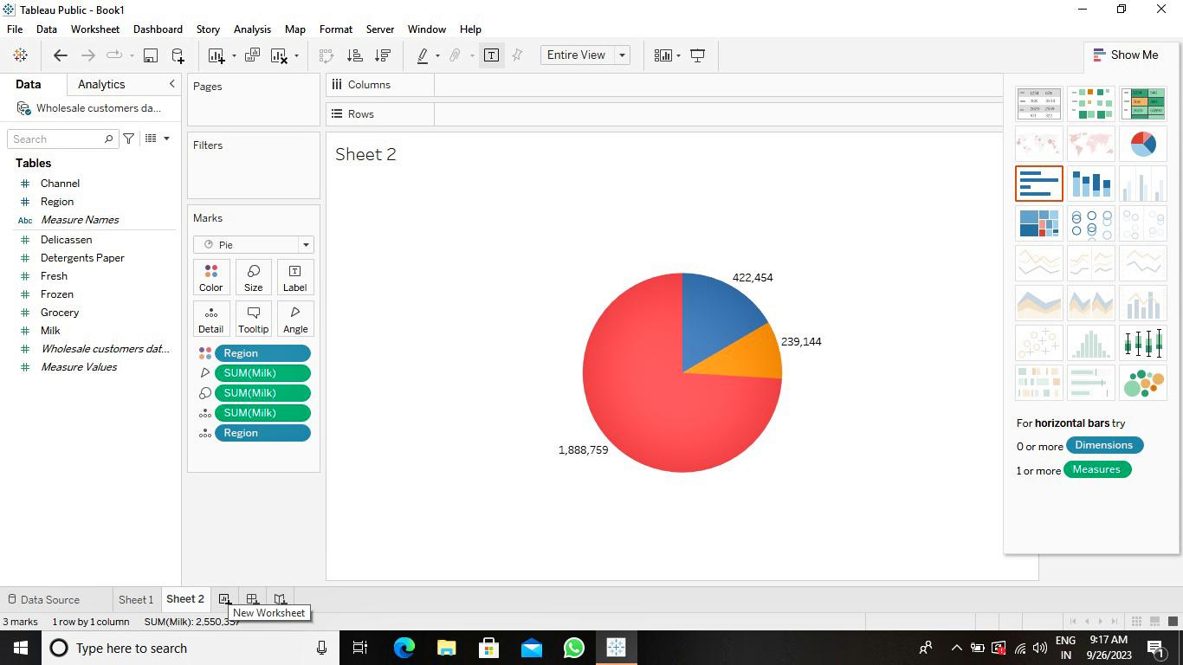
Region wise Milk

Slide 21
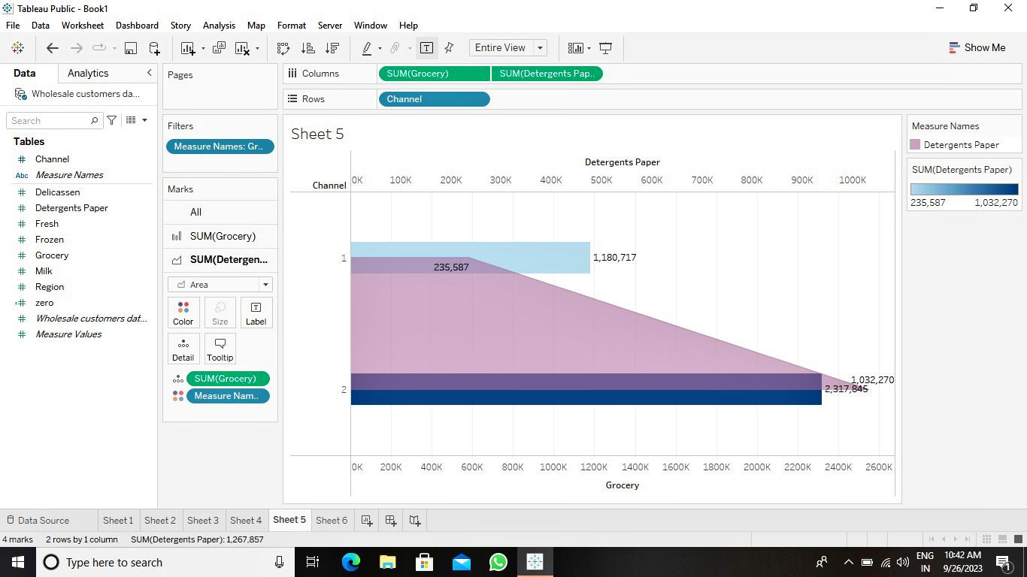
Channel wise Grocery and Detergent paper

Slide 22
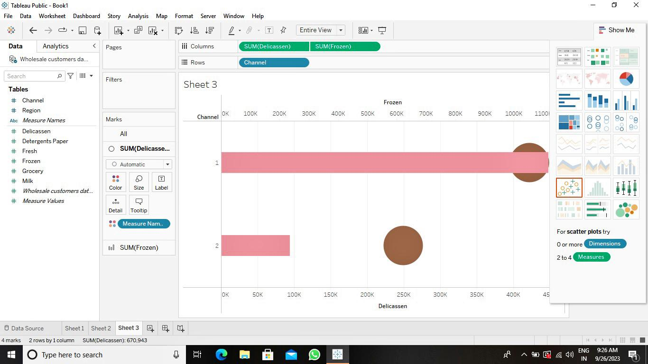
Channel wise Delicatessen and Frozen

Slide 23
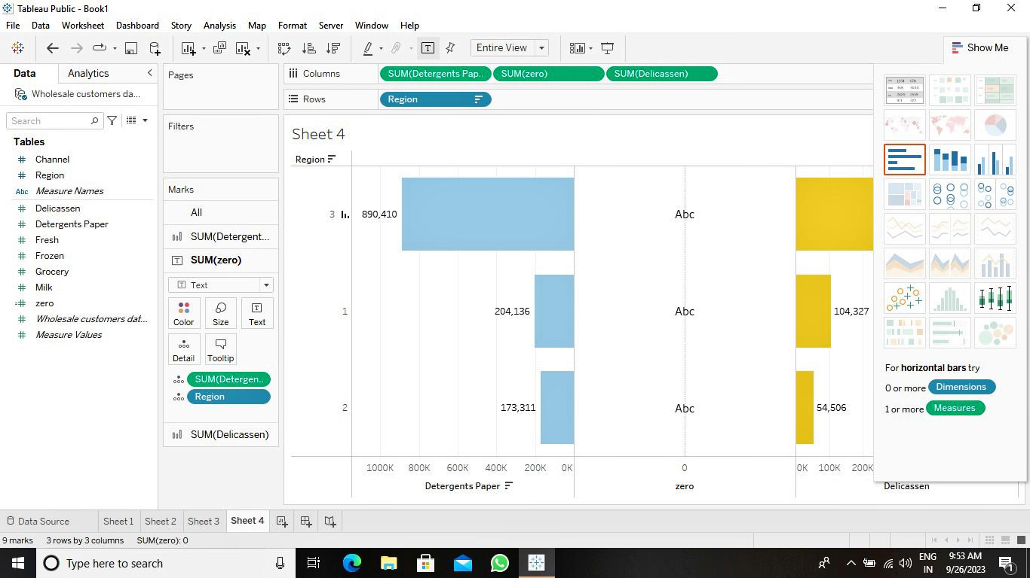
Region wise Delicatessen and Detergent paper

Slide 24
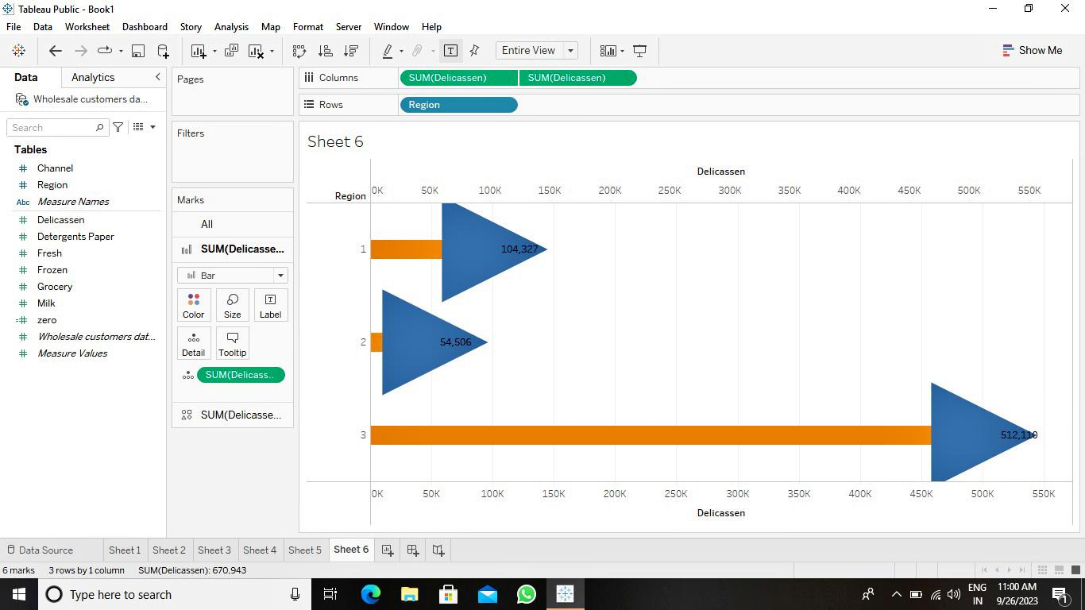
Region wise Delicatessen

Slide 25
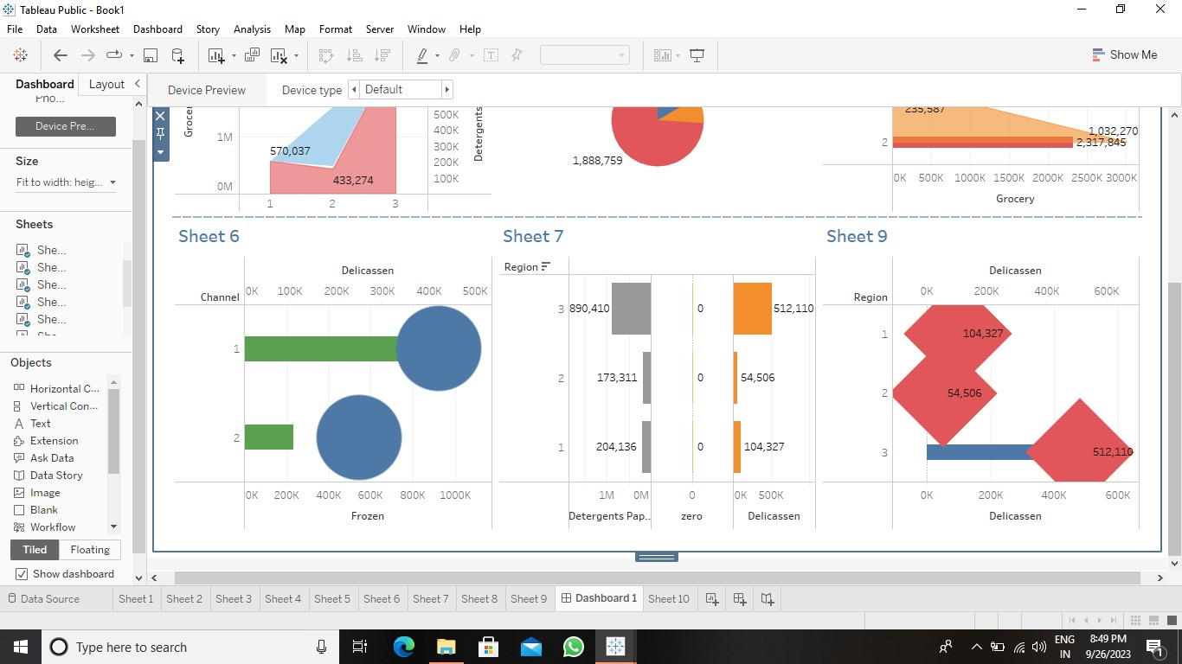
Dashboard

Slide 26
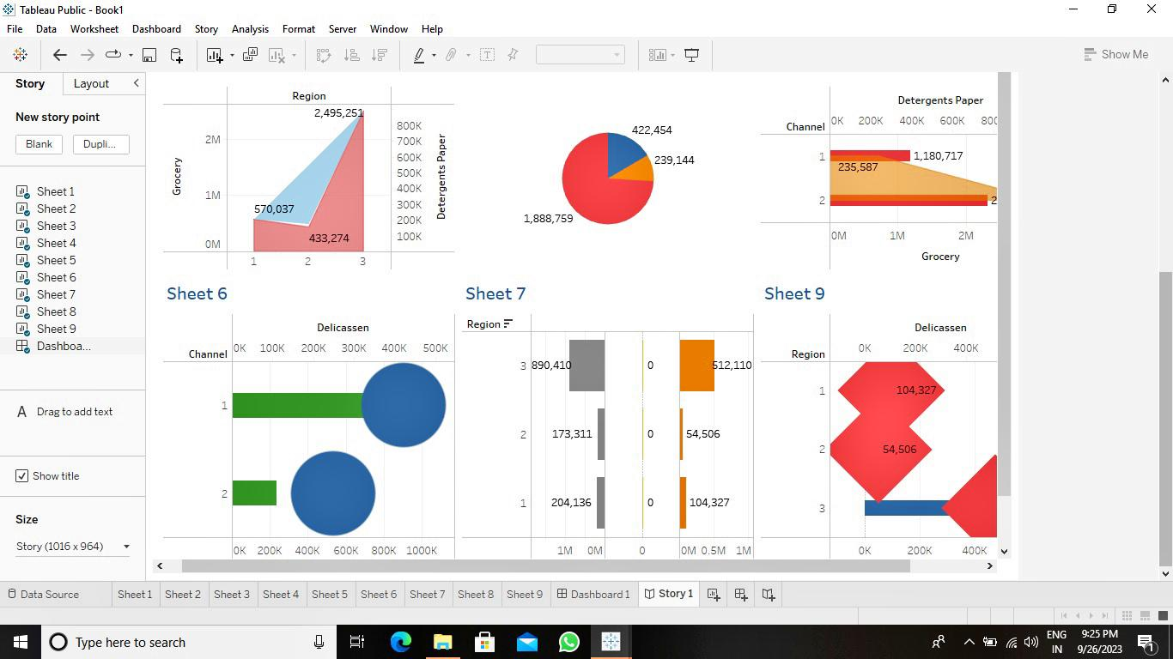
Story

Slide 27
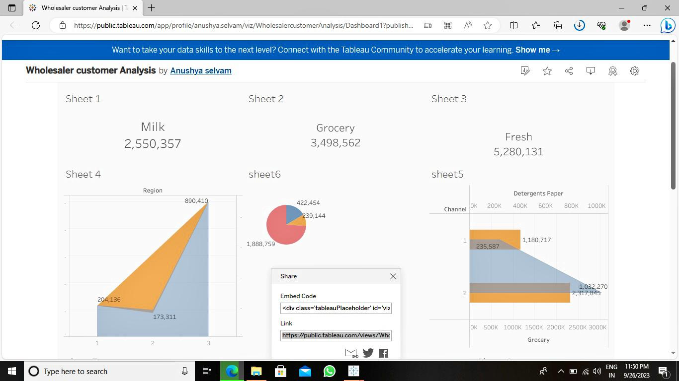
Published with link:
https://public.tableau.com/app/profile/anushya.selvam/viz/WholesalercustomerAnalysis/Dashboard1?publish=yes

Slide 28
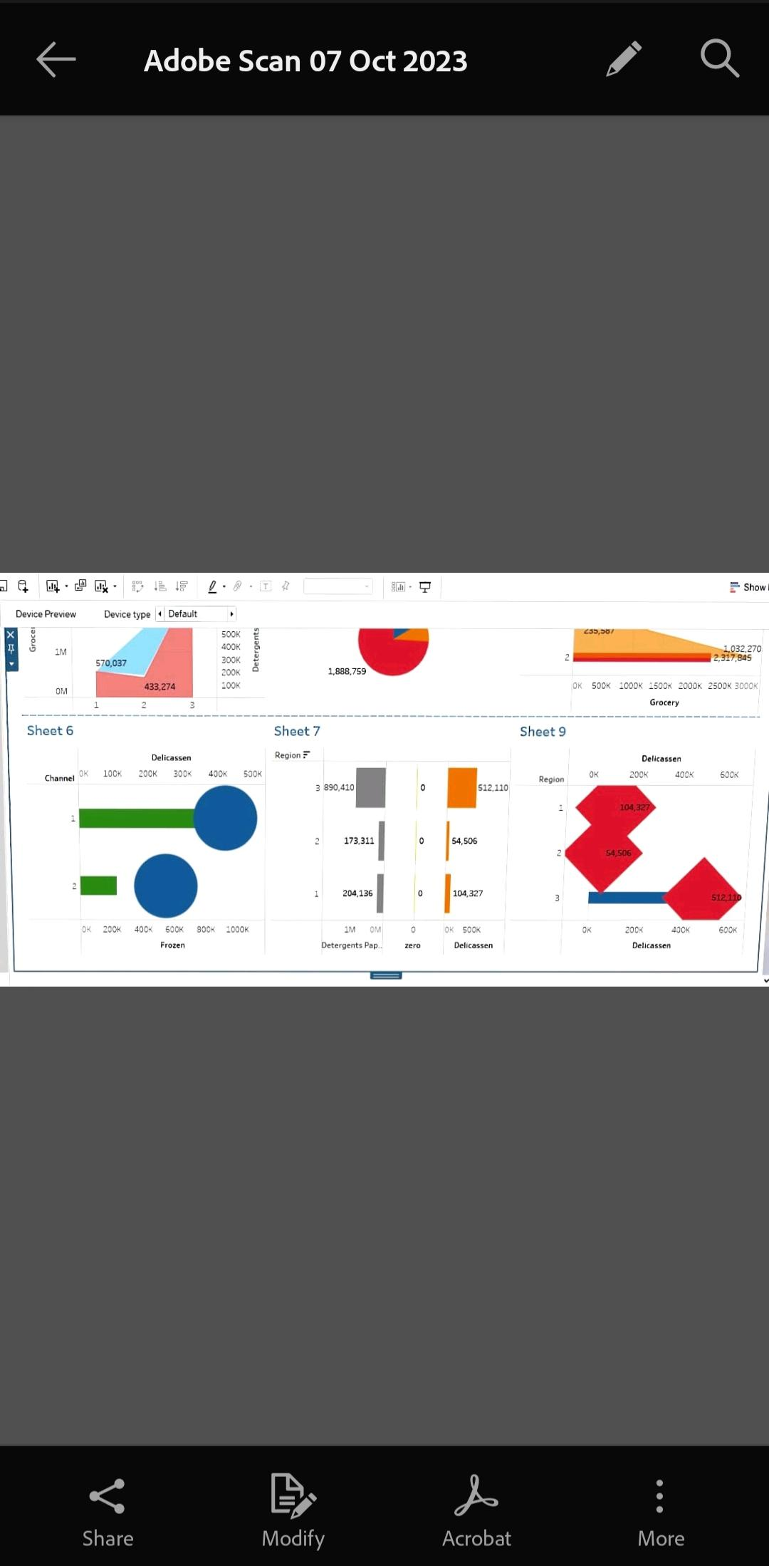
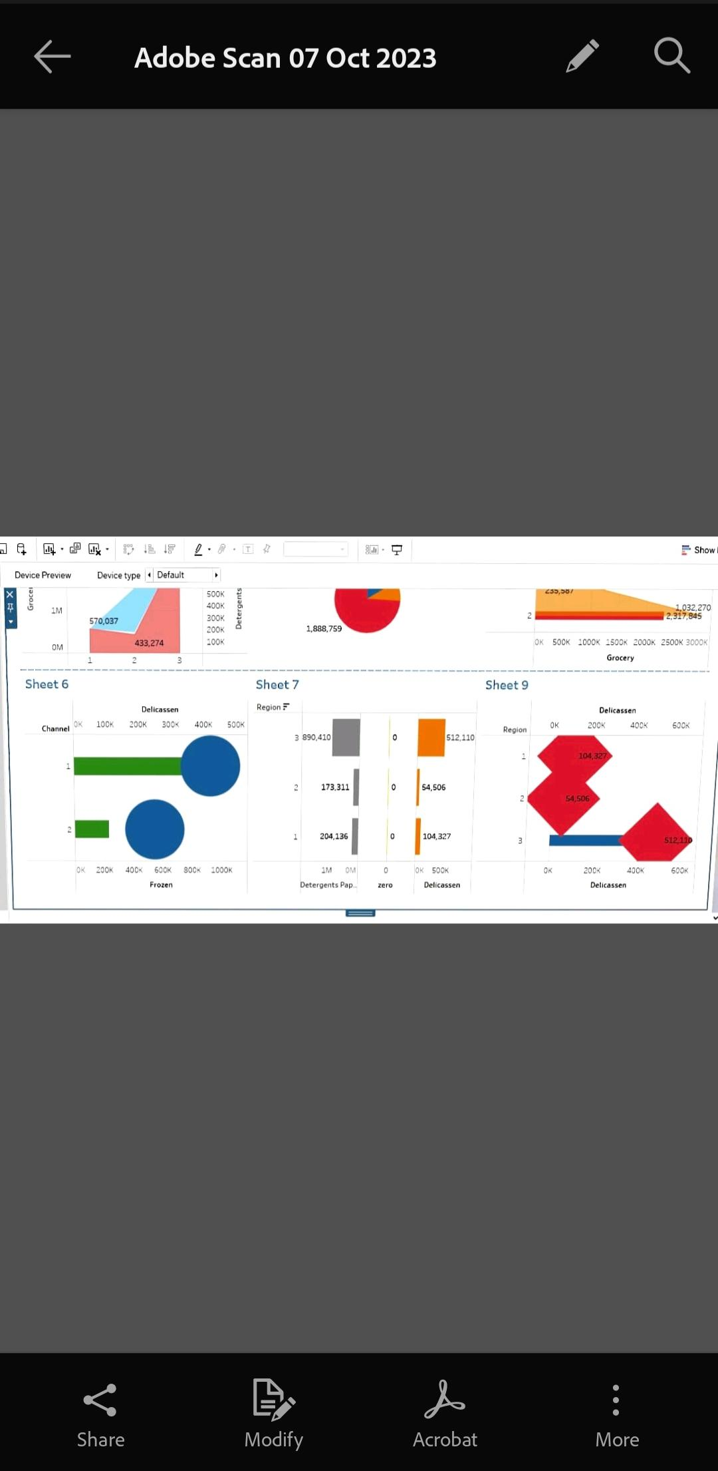
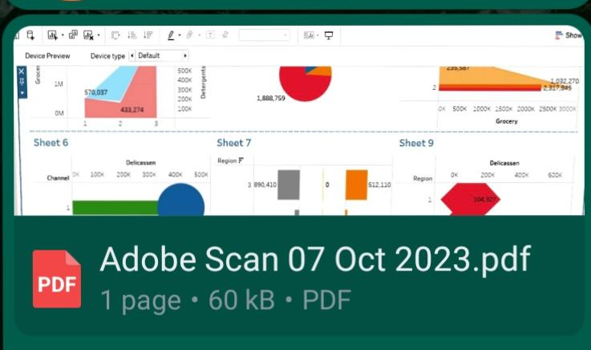
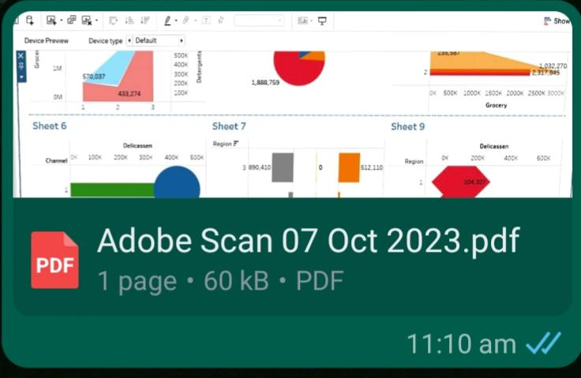
PDF FOR STORY AND DASHBOARD

Slide 29
THANK YOU

